Slide 1
Game Story

Slide 2
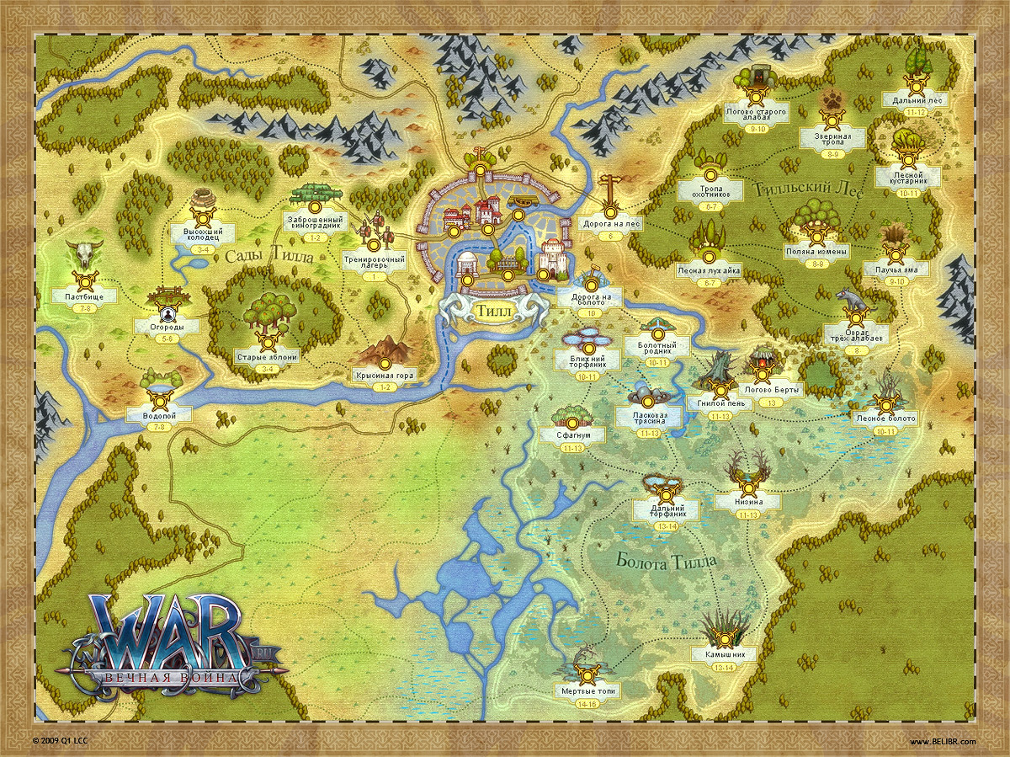
Map is Going To be Like This
Start Journey

Slide 3
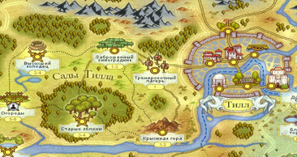
There is five region, controller by five different king.
Thief Region
Elf Region
Wizard Region
Dwarf Region
Human Region
Player will start journey from a village near the Thief Region. Player want to
help people from cruel or evil people of the regions and keep peace in the five
regions by controlling them.

Slide 4
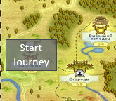
Player will fight from one village to another along the path to gain control over the area. Player will gain XP point by time. With that XP, he can level up his companion health and stamina. Along path the Enemy is going to be tough.
There will be central region, where king live. You need to fight with him to
gain complete control over the region.
Player Start Journey position of the map
At Start Journey point, he will meet the master (wise old man), who knew
the all about five regions.

Slide 5
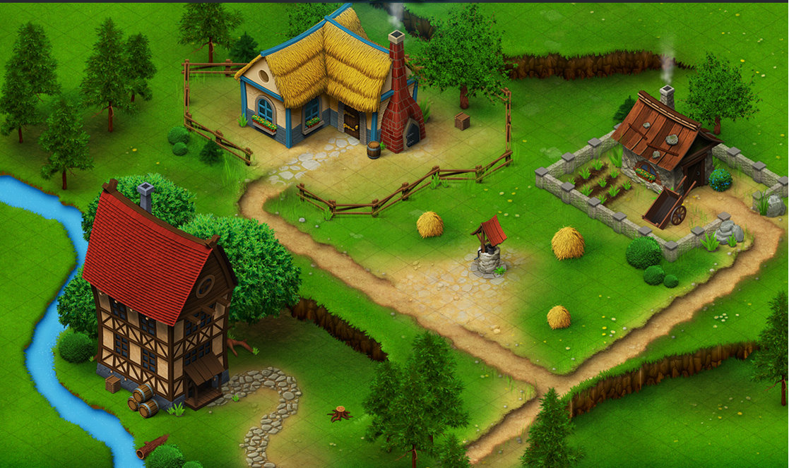
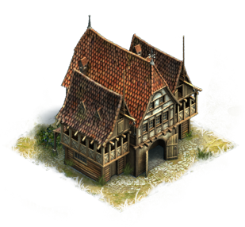
Meet Master(wise old man), who will help you in your destination…
Bar(Character
Customization Place)
Shop
Click Master Home to meet “Master (wise old man)”.
Master Home

Slide 6
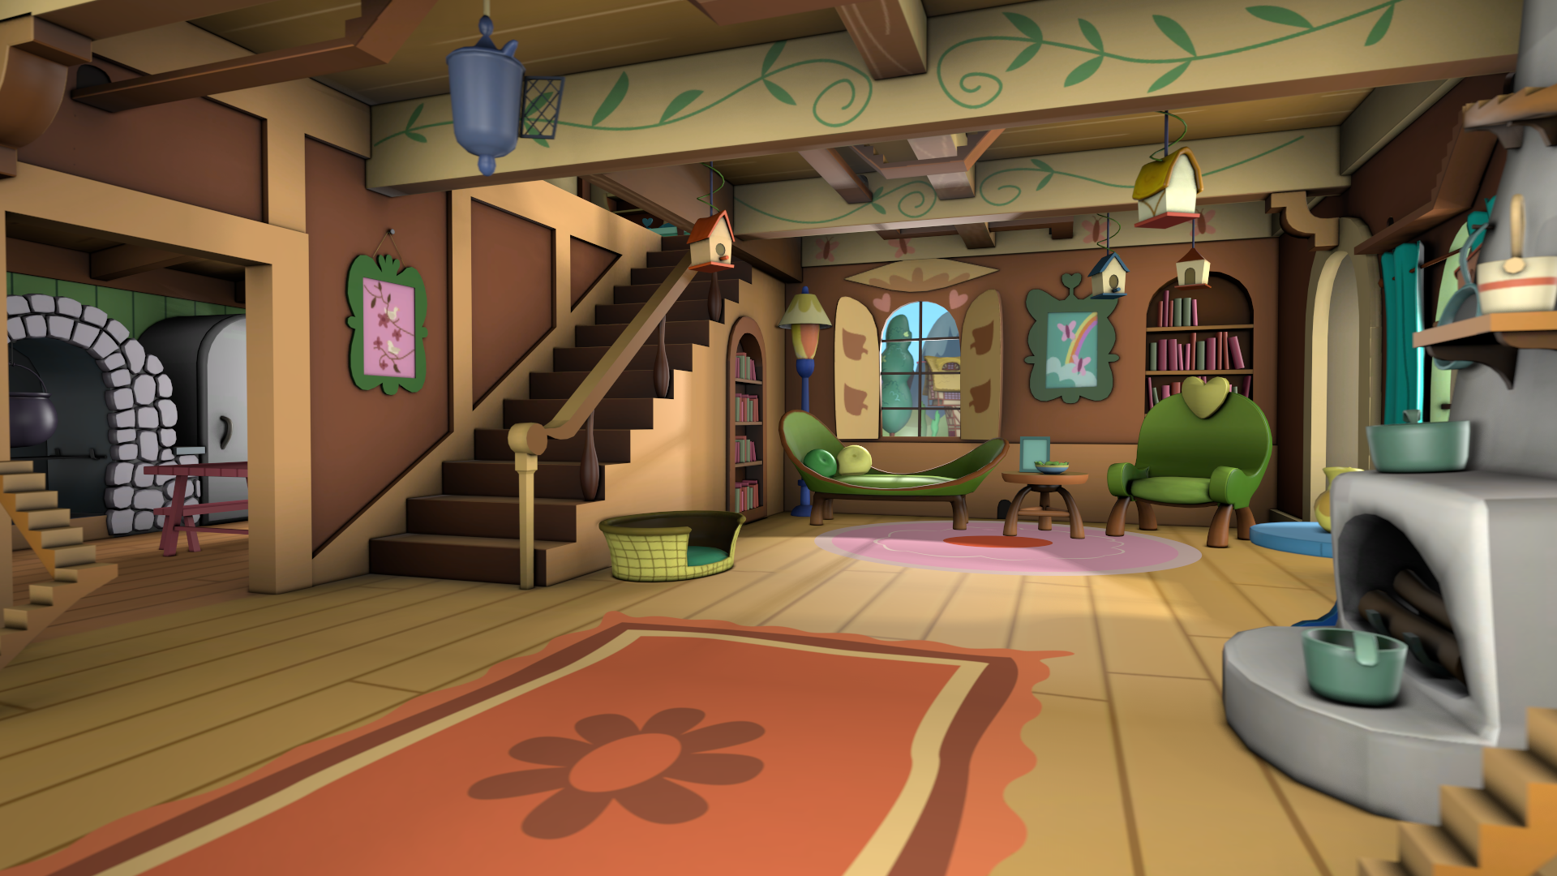
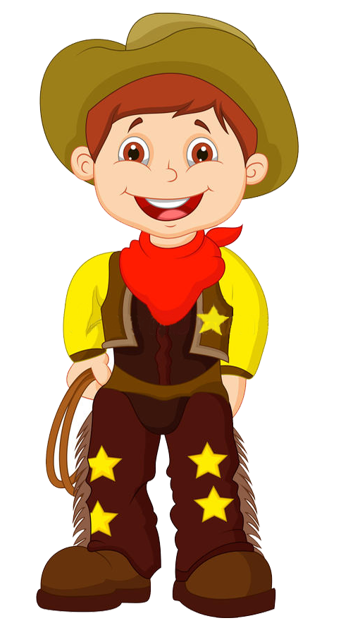
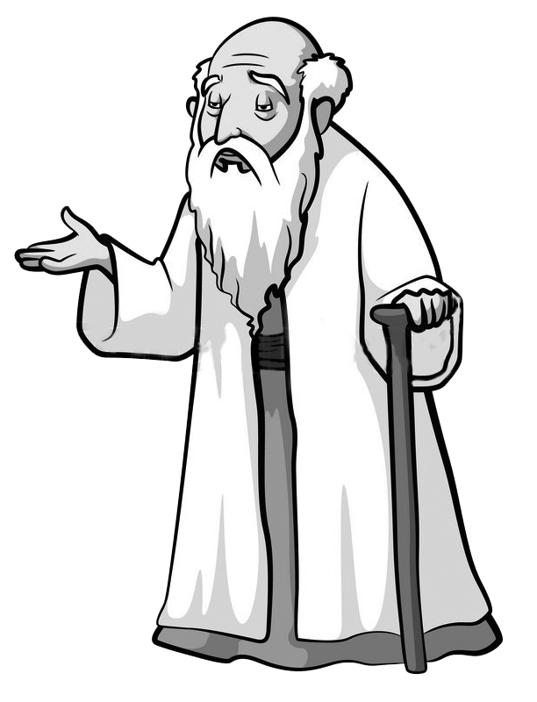
Beginning scene of the game…
Giving first objective…
Here “Bar” meaning where you can customize your characters.
Hello, Master.
Hello, traveler how can I help you?
You have tell me about five kingdoms, because I know you know all about the kingdom.
Now, you help me by giving me details about the kingdom..
Why you want know about it?
Because, I wand to help people who live in fear, because of king’s terror ruling.
Ok. I will help you, but you have to follow my advice.
Ok. I will follow your advice..
Your first objective is find your companion form the bars.
They will help you in your mission.
Ok. I will go to bar. Find my companion.

Slide 7
Select your character companion…
Bar(Character
Customization Place)
Click Bar to go character customization menu
Shop
Master Home

Slide 8
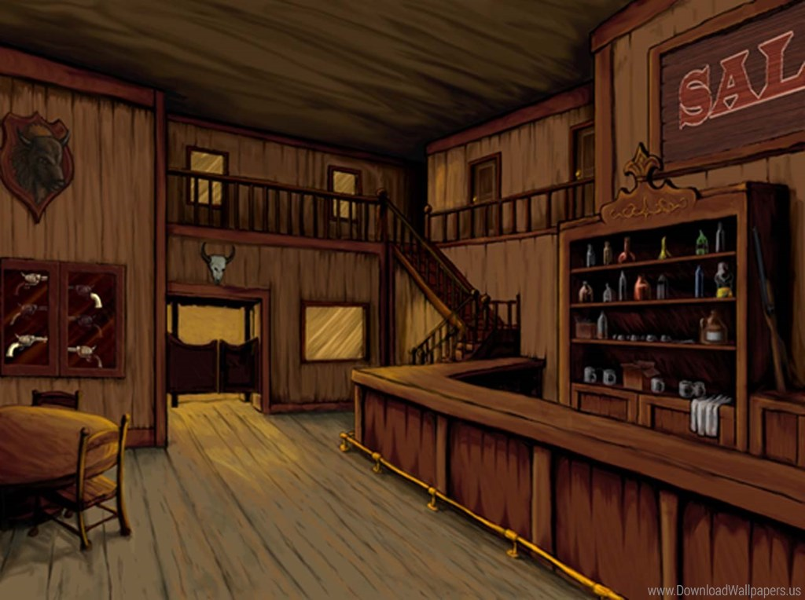
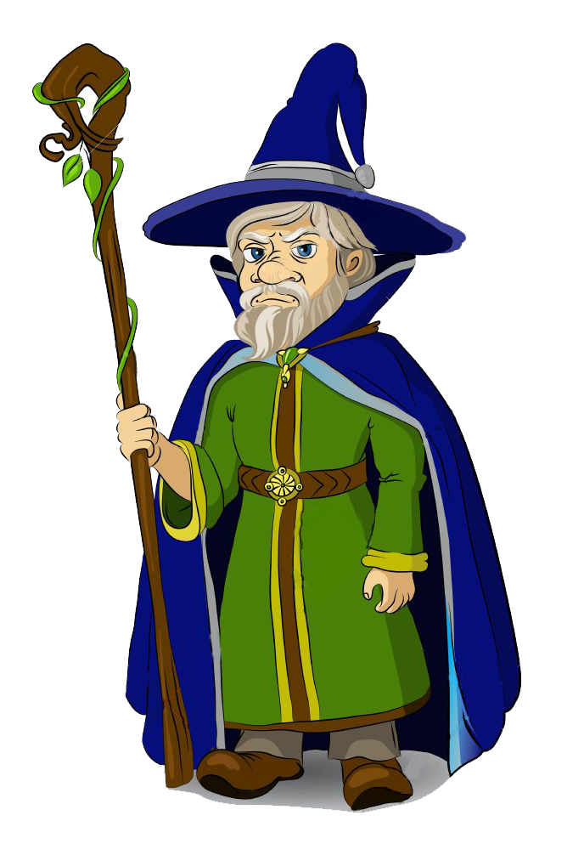
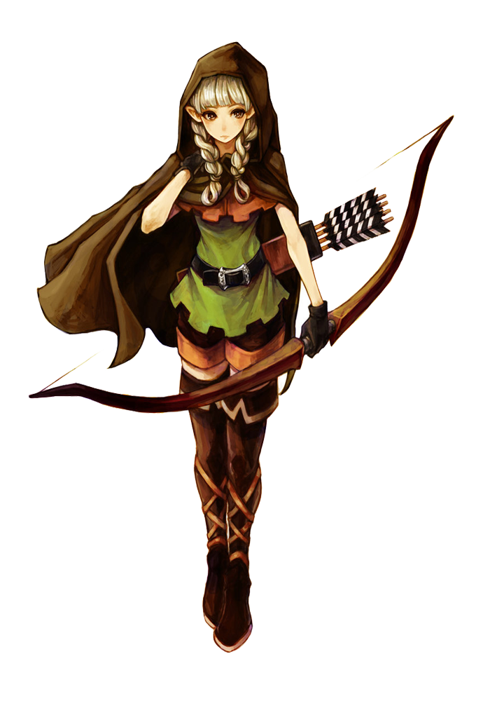
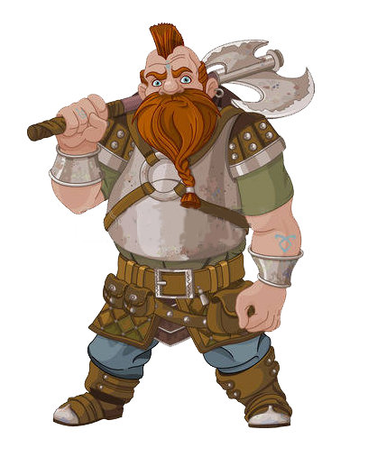
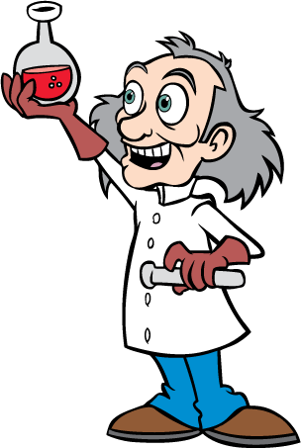
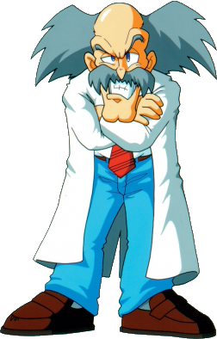
Player will select his companion… can select only three character.
Wizard
Elf
Dwarf
Doctor
Lab Scientist

Slide 9
Player
He has high punch power.
Abilities :
Punch (High punch power rest of the character)
Wizard
He has magical power.
Abilities :
Punch
Lighting (High Damage power)
To unlock magical power you have to
buy magic book and magic stick.
Dwarf
He has a sword with high stamina.
Abilities :
Punch
Sword (High Damage power)
You can unlock more damageable sword.

Slide 10
Elf
She has a bow. She can attack two enemies at a time with bow, but damage power is low
Abilities :
Punch
Bow (Low Damage power but higher than Punch power)
Player can unlock more damageable bow and arrow.
Doctor
He has healing power.
Abilities :
Punch
Healing (can heal any member of the party)
Player can increase healing power.
Dwarf
He can make high explosive.
Abilities :
Punch
Bomb (Area Damage)
Player can new explosion power by
gaining knowledge from book.

Slide 11
Meet Master again…
Bar(Character
Customization Place)
Shop
Click Master Home to meet “Master (wise old man)”.
Master Home

Slide 12
Giving Quest…
I selected my companion. Now what I will do.
Now you have to meet Henry (Villager).
Listen to his problem and help him.

Slide 13
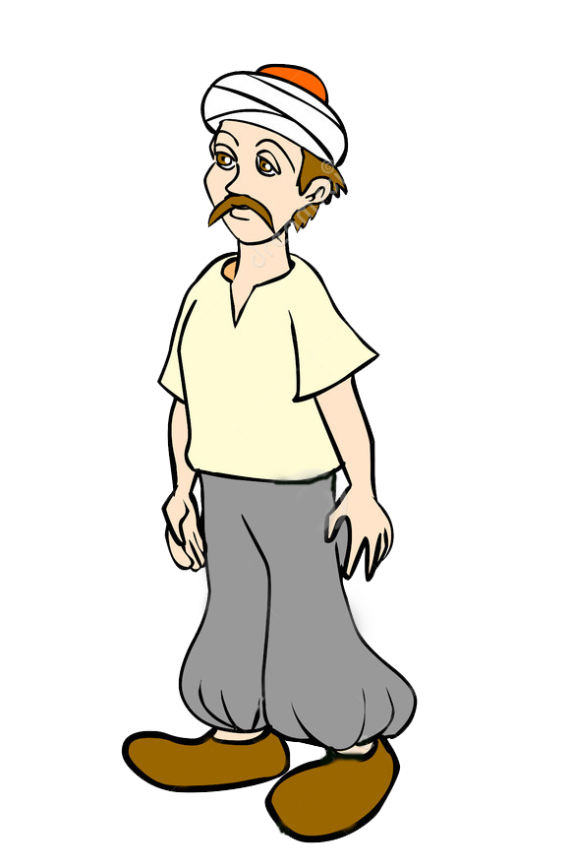
Helping villager…
Bar(Character
Customization Place)
Click villager character and start conversation.
Master Home
Help Me
By clicking on character with “help me” text, you can activate quest
Do want to activate quest?
Yes
No

Slide 14
Start conversation with villager…
Bar(Character
Customization Place)
Hello, I hear that you need help. I am here to help you.
Yes, I need help. There is some thieves who always come here and take away every thing from us. I want from you to stop them.
Shop
Ok. I will stop them.
Master Home

Slide 15
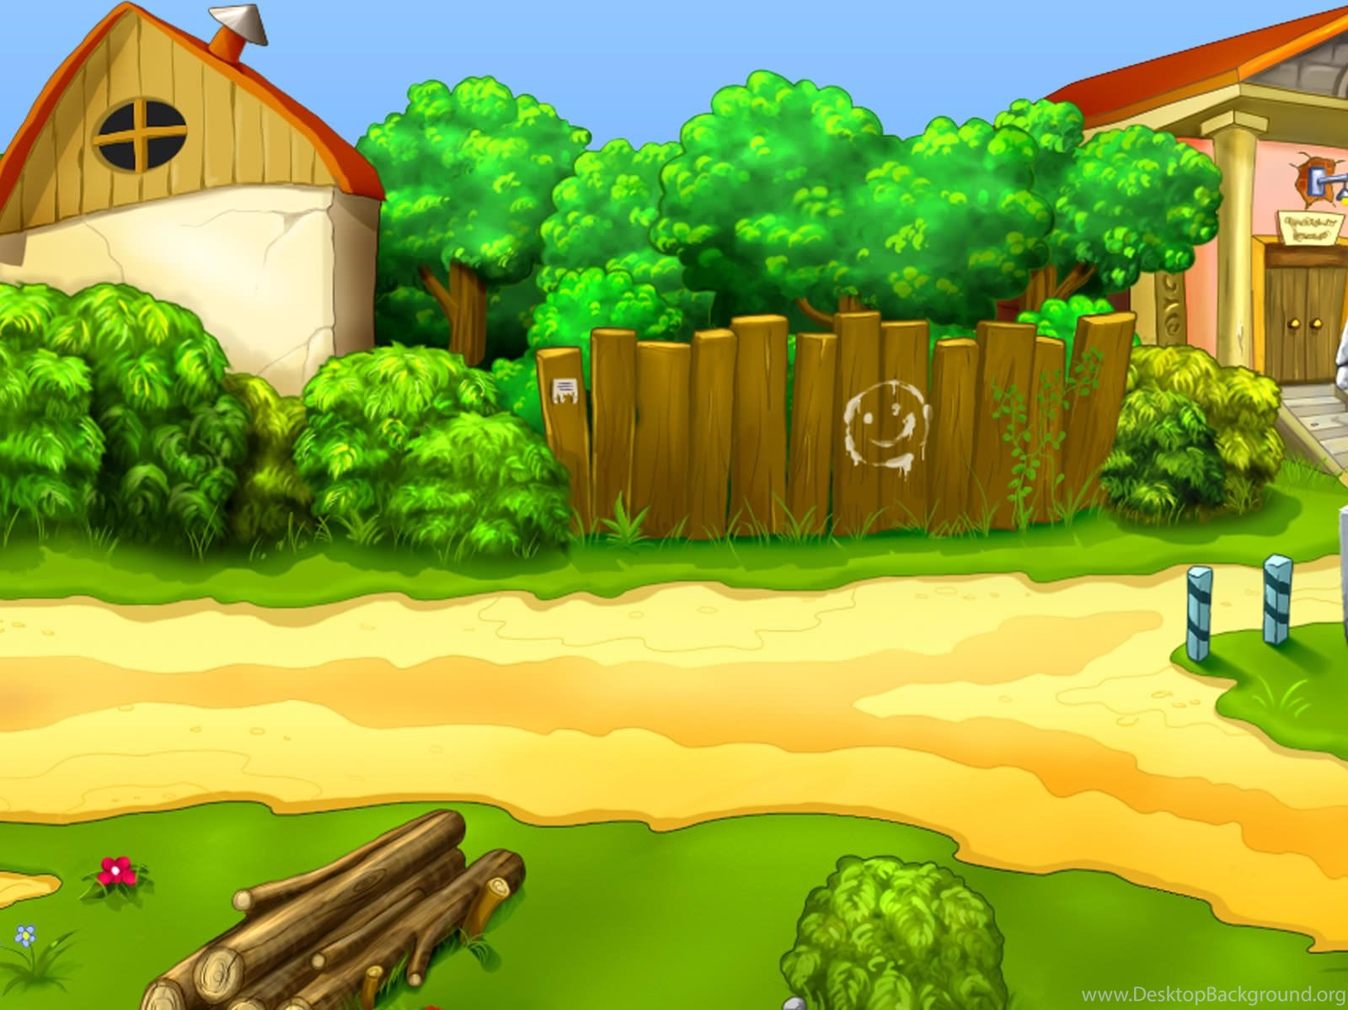
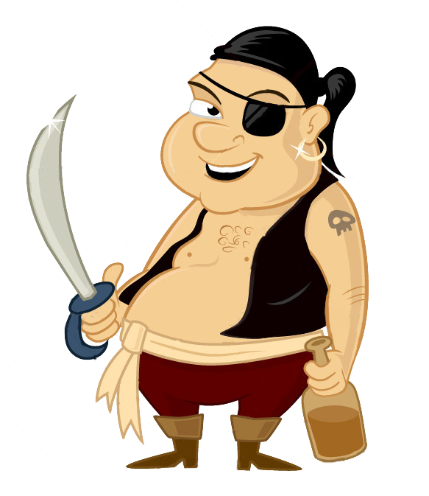
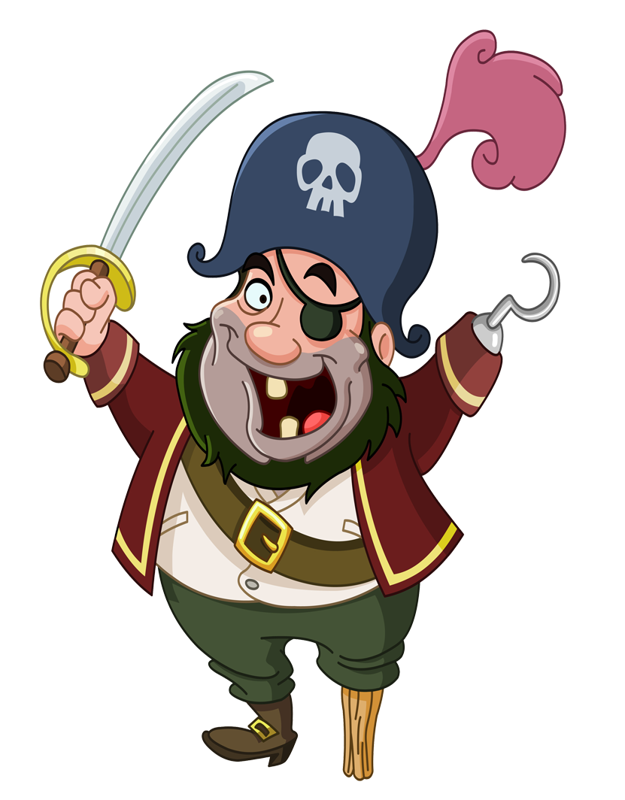
Fighting with thieves…
3
4
Why are you come here and loot them?
They are poor people.
1
We loot them for money.
Today we come here to loot these villagers. Get out of our way, otherwise we will fight with you guys.
2
5
6
Ok, then let’s fight.

Slide 16
Fighting with thieves…
You Win!
Loots:
1500 coins
*Rewards*
1500 coins
+ 300 bonus coins
We win the fight.

Slide 17
After the fight with thieves…
Bar(Character
Customization Place)
Thanks for helping.
Here is your reward.
You are welcome.
I am happy to help you.
Shop
Master Home
Meet the Master…

Slide 18
Giving another Quest…
I help the villager and he give me
some money. What will I do with that?
That’s great. You need to buy some stuff from shop. After that come back.

Slide 19
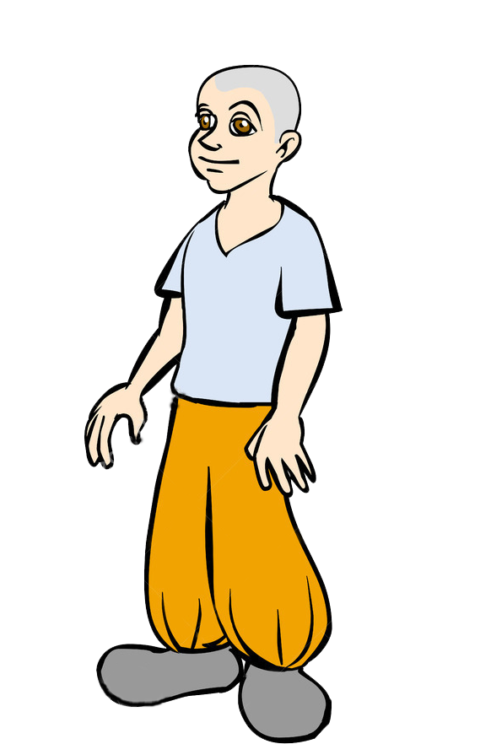
Helping shop’s owner(Henry)
Bar(Character
Customization Place)
I am here to buy some stuff from your shop.
Shop
Ok. Here is the items
I have in the shop
Master Home

Slide 20
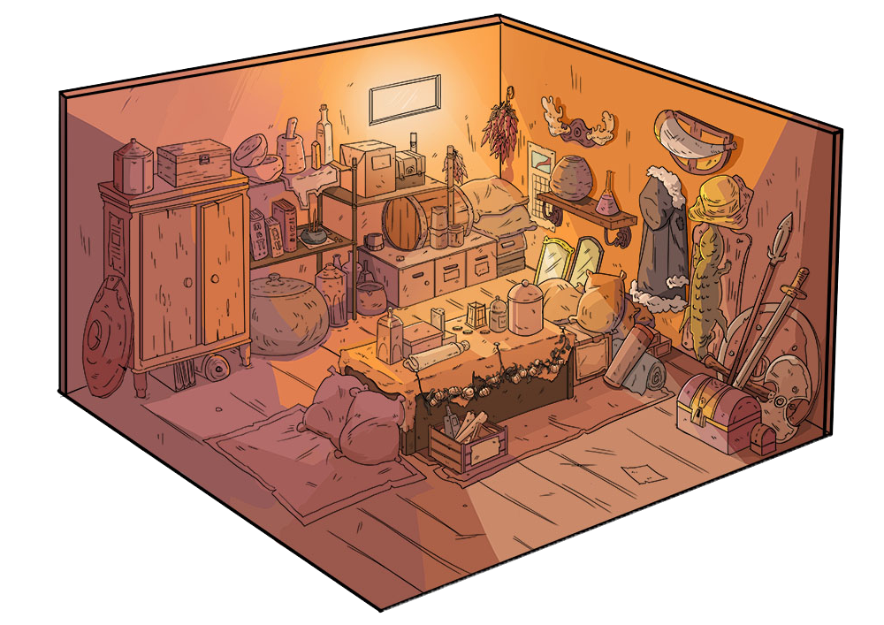
Buy a bow and 30 arrows.
Buy magic book.
Weapons
Wearing
Consumable
Crafting Item
$ 1500
Your Inventory
After that meet Master…

Slide 21
Giving First Main Mission…
I buy the stuff.
Now what will I do?
Ok, now I will give the main mission.
The mission is to clear outpost.
By clearing outpost you can reduce king’s affect in the area.
Ok. I will clear the area.
After clearing area,
meet me in my there.

Slide 22
Travel to destination point shown in the map…
By clicking on red dot you can travel to that position…
Destinatio Point
Start Journey

Slide 23
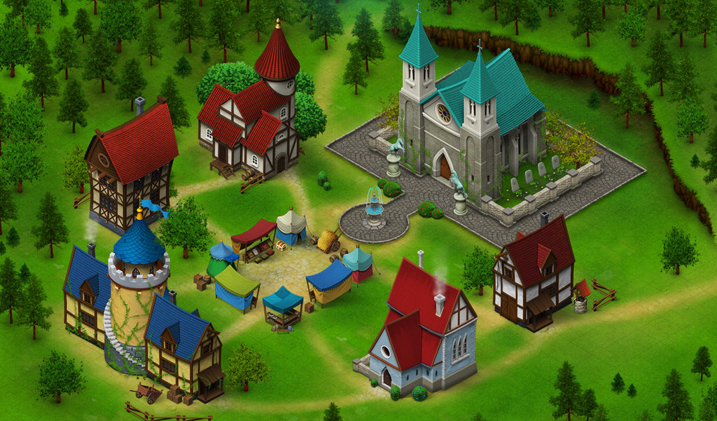
Village 2
Clear Area(Fight with enemy)
First clear the area, then come to me.
Master Home
Do you want clear area(post name)?
Yes
No

Slide 24
Fighting with guards of the outpost…
3
4
Guys, these people come here to die.
Kill them…
2
1
Let’s see who is going die…
5
6

Slide 25
If Player lose the fight…
YOU LOSE
1
Rewards : 0
If Player lose the fight, Player have fight back. To fight back Player have recover
his companion character health and stamina. Also repair character’s weapon
like fill up our arrow, repair sword of dwarf.

Slide 26
If Player win the fight…
YOU WIN
1
Rewards : $1500
If Player win the fight, Player will unlock new quest and next mission.
The Player can play side mission(quest) or main mission.(Player can upgrade character
and weapon buy playing side mission).

Slide 27
Village 2
You clear the area…
Master Home

Slide 28
Conversation with Master.
I clear the area.

Slide 29
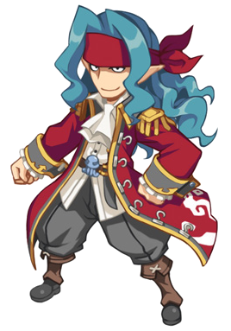
In this way Player will capture the outpost.
Player will fight with King of that particular area.
After wining the fight with king, he will unlock new character of that region.
New character will have more damage power and stamina.

